Slide 1
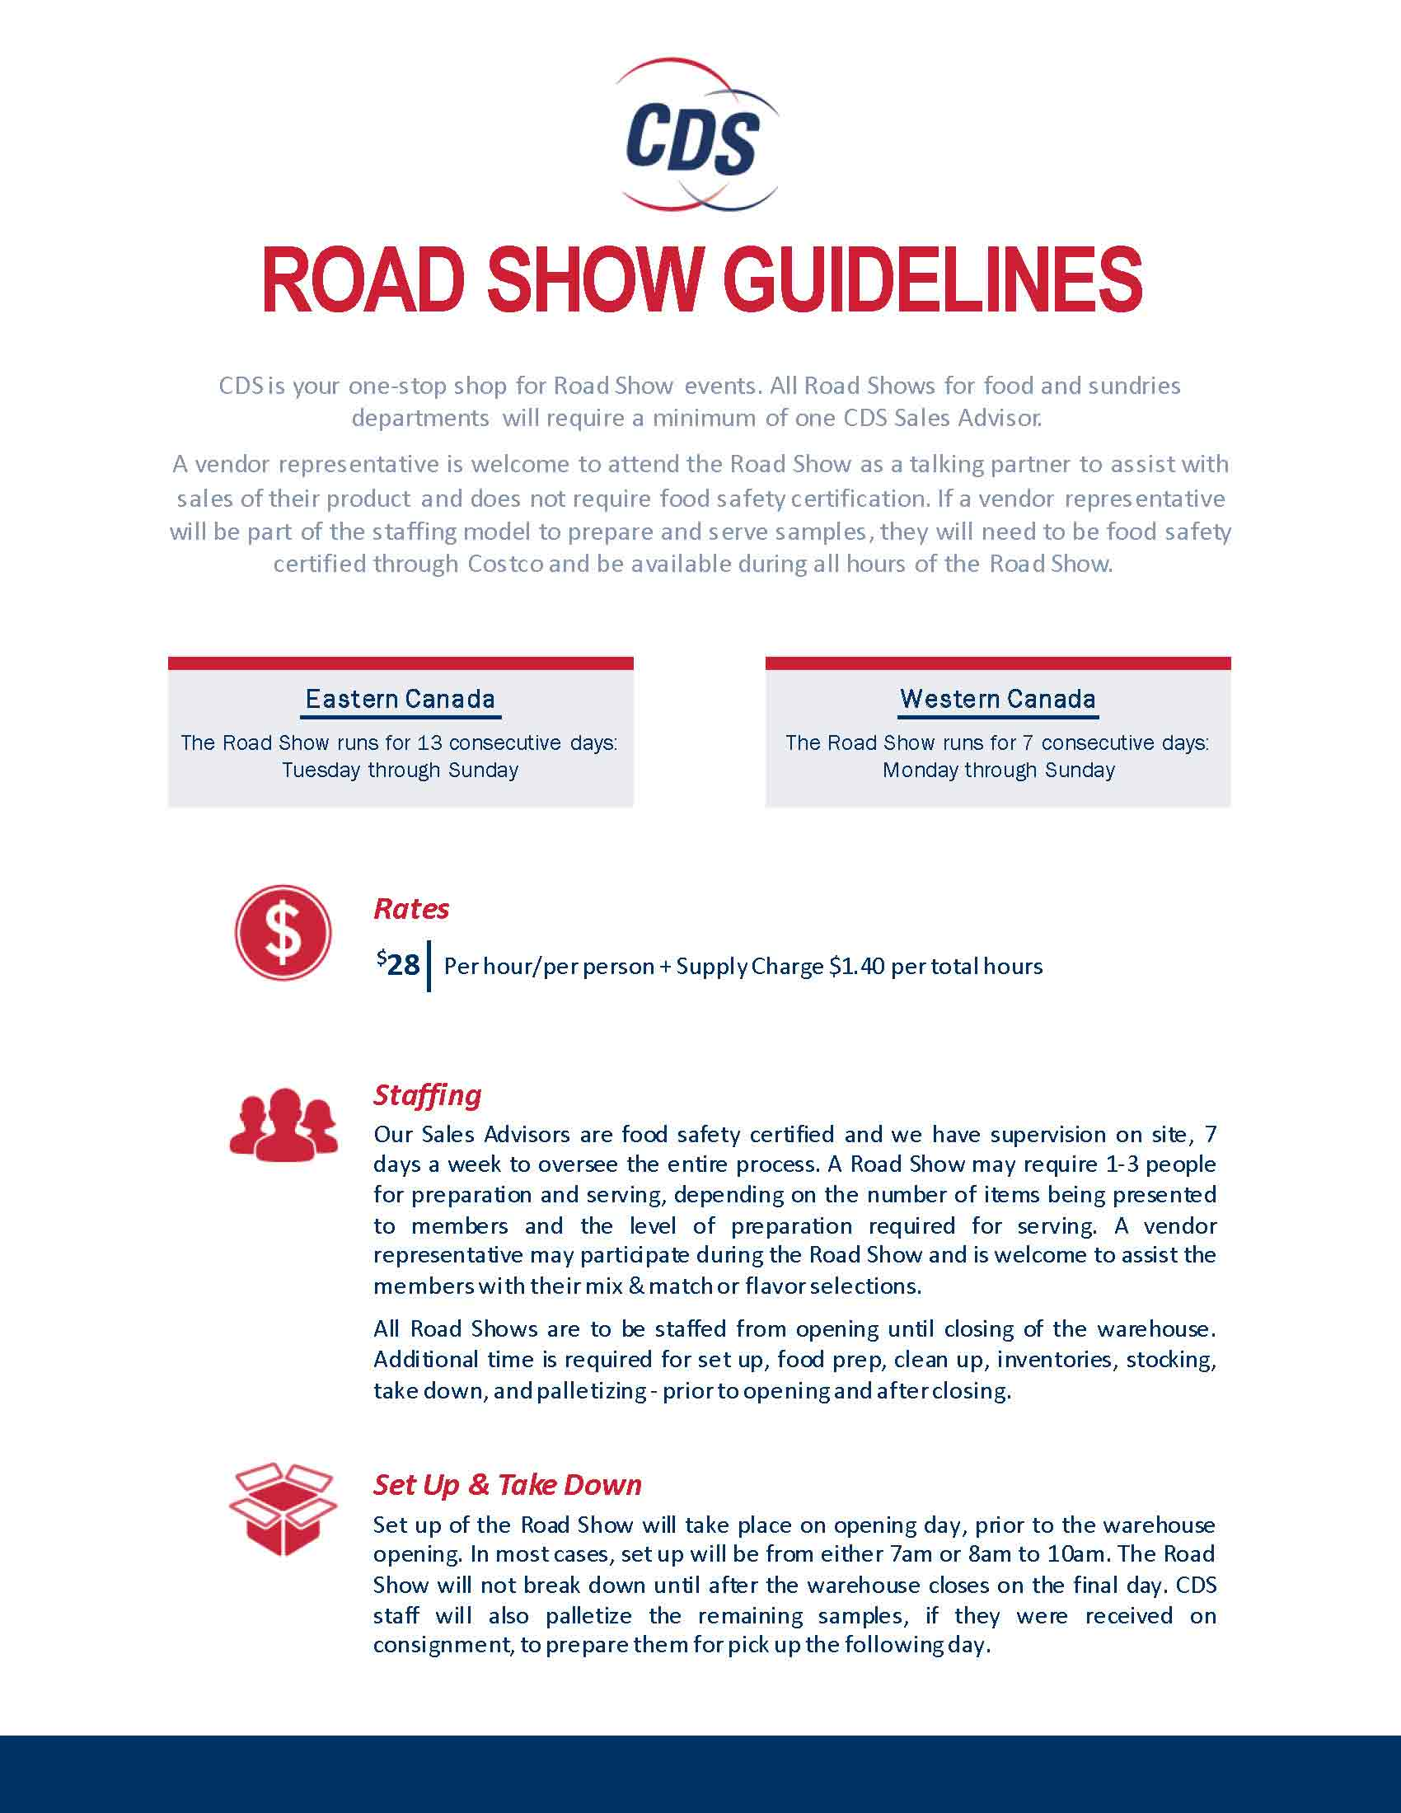

Slide 3
ROAD SHOW QUICK INFO SHEET
E-mail completed form to mburcham@clubdemo.com
Vendor Account Name
Contact Name, Phone number, E-mail
Road Show Dates(s)
Warehouse Locations(s)
PO# (only required if your account is set up to require PO# to pay invoices)
Department
Costco Item # and Description for each item
Mix & Match Item Number, Pick and flavor varieties
Is demo product taken from consignment or purchased
Prep instructions
Enhancements needed to prep or serve the item demonstrated
The number of sales advisors per day (i.e.1 SA Mon-Fri; 2 SA Sat-Sun)
Inventory days requested
Will CDS perform daily stocking for your product?
Road Show Equipment Rental options- -One Cooler for $78 -Two Coolers with Prep Counter for $250.00 -Prep Counter for 95.00
Provide Road Show Manual with details for set up, food prep, key selling attributes, palletizing, etc. for Road Show

